Slide 1

Azure AI Foundry
The unified AI platform

Slide 2



Agentic AI
Reason over a provided business process
AI agents can plan, adapt to new information, and execute tasks independently, making them capable of handling complex, dynamic environments, decision-making and autonomous action. They can learn from feedback, adjust their strategies, and operate with minimal human oversight.
Retrieve context to complete the process
Perform an action for the end-user
Notes:
An AI Agent automates and executes business processes, nearly autonomously
AI agents can plan, adapt to new information, and execute tasks independently, making them capable of handling complex, dynamic environments, decision-making and autonomous action. They can learn from feedback, adjust their strategies, and operate with minimal human oversight.

Slide 3
Organizations face challenges automating business processes because they…
Are poorly defined
Require manual interventions
And rely on unstructured data
Notes:
Organizations often encounter several significant challenges when dealing with complex, manual, and time-consuming workflows with minimal process automation:
Poorly defined – it’s unclear what steps are necessary to complete a process because they aren’t documented. This often requires process mining, which can be expensive
Manual interventions – people need to proactively review the process as it’s progressing to ensure its completion. With typical automation, steps get obfuscated by people.
Unstructured data – most processes are driven with emails and docs which existing automation systems can’t handle (which forces humans to fill out forms)
Expensive – building an automation often disrupts the existing process because it requires new portals and systems for users to learn

Slide 4

With AI agents, you can make your processes faster than ever
Tomorrow
Automated agents
Today – RAG
Chatbots
New account
Yesterday – manual
Forms over data
Agent
New account
New account
Chatbot
Other apps
HR manager
Approve?
HR manager
HR manager
New employee form
New employee form
New employee API
Automation
Automation
Automation
Improve employee productivity
Improve process efficiency
VALUE

Slide 5




Agentic AI capabilities
Web Search
Memory
Self-critique
Code Execution
Subgoal decomposition
Tools
Agent
Planning
Calculator
Collaboration
Calendar
...many more design patterns
Action
...more

Slide 6
4 primary considerations
Successfully developing AI Agents requires
K
Knowledge
Actions
Security
Evaluation
Providing agents with the right context
Giving them the tools to complete their tasks
Ensuring they only have access to what they should
Ensuring they complete their tasks correctly

Slide 7


Enterprise-grade Security
Bring your own storage
Keyless setup and authentication
Private Virtual Network support
Tracing/ monitoring
Content filters
Notes:
So, we know that in order to mitigate and manage risks, we first need to identify and prioritize them.
When GPT-4 first came out, Microsoft brought together a group of experts to test the technology and understand what the potential benefits were.
We also started digging into the potential risks that we would need to mitigate.
The first category of risk is overall quality of the application.
We want to ensure that the application is not producing errors or what people often call hallucinating, which would be like adding additional incorrect information or just sort of making up information.
We also need to make sure that our system is robust to adversarial attacks.
This could be a jailbreak, which is when a user tries to manipulate or confuse the system to get it to produce something that it’s supposed to produce, or new types of attacks like prompt injection attacks, where an attacker embeds hidden instructions in data sources like emails or documents.
We also look at traditional harmful content, whether that is harmful natural language content, for example, or harmful imagery or code that contains security vulnerabilities.
Then one of the newer areas that’s emerging is that these models can seem very human-like when interacting with end users.
When is it okay for a system to be conversing and acting like a human? And when is that going to be misleading, inappropriate, or harmful?
We’re looking across all of these different dimensions, which may sound like a lot, but we’ve found that same technological approach or the same sort of layers of defenses actually work for each of these different types of attacks.

Slide 8









Spectrum of Agentic Solutions
Memory
history of work
User Proxy Agent
CoordinatorAgent
LLM
Agent
LLM
conversation
LLM
question
query
data
prompt +
data
prompt
answer
Service
Agent
LLM
Retrieval
Agent
LLM
Analytics
Agent
S
LM
Coding
Agent
SLM
document
summary
Search
docs
input
output
query
data
data
Web Service
Search
databases
docker
docs
No Agent
Very narrow one shot task
Ex: log to JSON
Single Agent
Very clearly scoped iterative task
Ex: providing an answer with supporting evidence to a complex question
Multi-agent Systems
Wide scope complex use case requiring diverse skills
Ex: Propose 2 Instagram marketing campaigns including assets that would leverage the top 2 recent trends in our past quarter US Sales to boost our mailing list user base and predict the impact of each campaign

Slide 9
Key Use Cases Across Industries
AI Agent workflows can enhance efficiency, accuracy, and customer satisfaction
Travel Booking & Expense Management
Employee Onboarding
Personalized Customer Support
Data Analytics and Reporting
Assists employees in booking business trips
Integrates with Tripadvisor, Outlook, and SharePoint
Books via Teams chat or email
Uses OCR to gather receipts
Automates expense report submission and tracking
Personalized onboarding assistant for new hires
Uses LLMs grounded in HR data from SharePoint
Provide relevant training materials
Schedule orientations and set up software accounts
Monitor task completion and ensure efficient onboarding
Diagnoses issues by referencing history and product manuals
Provides tailored solutions or escalates through automated workflows
Creates tickets and schedules follow-ups
Updates CRM records, enhancing future support
Analytics data from data lake and data warehouse
Responds to user requests in natural language
Generates insights, visualization, and sends via Teams or email
Automates data handling for real-time, effortless decision-making

Slide 10




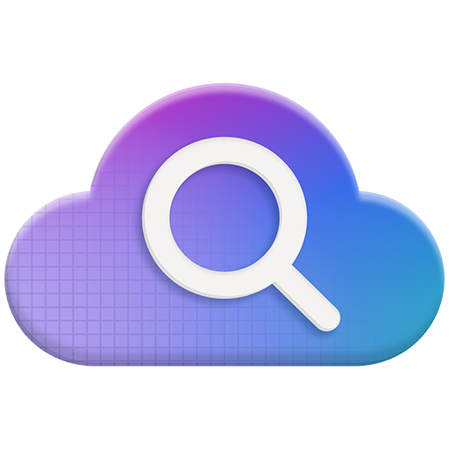




Azure AI Foundry
Model Catalog
Copilot Studio
Foundational models
Open-source models
Task models
Industry models
Visual Studio
Azure OpenAI Service
Azure AI Search
Azure AI Agent Service
Azure AI Content Safety
GitHub
Evaluations
Customization
Governance
Monitoring
Azure AI Foundry SDK
Observability

Slide 11









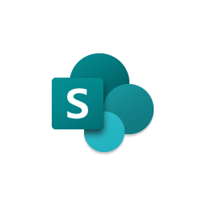























Azure AI Foundry
Ingest data
 | Microsoft Fabric |  | Azure SQL Database
 | Cosmos DB |  | Azure AI Search
 | Azure Redis |  | SharePoint
 | Bing |  | OSS Databases
Orchestrate with OSS frameworks
 | Semantic Kernel |  | LangChain
 | AutoGen |  | LlamaIndex
Leverage Azure App Services
 | Functions |  | Kubernetes
 | Container Apps |  | Logic Apps
 | Dynamic Sessions |  | PubSub
Open and Modular Platform
Provision cloud resources
 | Compute |  | Storage
 | Data |  | Identity
 | App Hosting |  | AI Services
Monitor in production
 | Azure Monitor |  | Arize
 | Azure App Config |  | Weights & Biases
Microsoft Copilot Studio
Microsoft Power Platform
Azure AI Foundry portal
Azure Machine Learning
GitHub Enterprise
Visual Studio Code
Azure DevOps
Microsoft Azure Portal

Slide 12


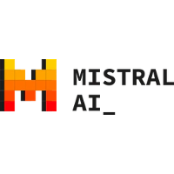







Azure AI Foundry
Support for diverse selection of models
Now 1800 + Frontier, task, and Open Models
OpenAI Model Family
(available day 1)
Phi SLM Model Family
Mistral AI Model Family
Meta Llama 2 Model Family
Jais G42 Model Family
Cohere Model Family
Databricks Model Family
Hugging Face Collection
New
New
New
Industry AI Models

Slide 13
Azure AI Foundry
Azure AI Foundry is “agent-first”
Models
Context
APIs
Agents
Agent
Agent
Agent
Agent
Agent
LOB Apps
Biz Ops
New APIs
New Agents
New Value
New Value
New Value
New Value

Slide 14
Azure AI Foundry
Azure AI Foundry Code
from azure.ai.projects import AIProjectClient
from azure.identity import DefaultAzureCredential
project_client = AIProjectClient.from_connection_string(
credential=DefaultAzureCredential(),
conn_str='Project connection string',
)

